Slide 1
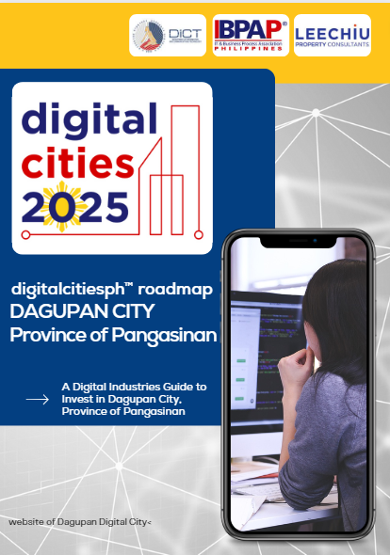
DIGITAL CITIES ROADMAP BATCH 3
Notes:
Roadmap Validation for the 5 Digital Cities
Mock Presentation for the Target Digital Cities
Pre-presentation (Briefing)
They will present and the panel will give comment

Slide 2
WHY DAGUPAN?
Dagupan City in Pangasinan is the Center of Education in Region 1. It has produced about 60% of talent workforce. The top disciplines are Engineering and Technology, Business Administration, Education Science and IT Related course which supplies the manpower requirement of the IT-BPO industry.
Historically, Dagupan is the Center of Trade and Commerce in the region. There is a concentration of banks and financial institutions in the city. It is also a major transportation hub in the province.
Stable internet services and complete medical facilities as it sits the Regional Medical Center.
It took the first female City Mayor of Dagupan to envision the Digital City program for its citizen. She is an entrepreneur and has experienced building the large enterprise like chains of malls and real property developments.

Slide 3
TALENT
Dagupan City in Pangasinan is the Center of Education in Region 1. It has produced about 60% of talent workforce in the region.
The city is home to major universities and colleges such as the University of Pangasinan-PHINMA, University of Luzon, Lyceum Northwestern University and Colegio De Dagupan which have gathered high educational accreditation.
The top disciplines by percentage of graduates are Engineering and Technology, Business Administration, Education Science and IT Related courses which supplies the manpower requirement of the IT-BPO industry.
For the past three years, the number of tertiary graduates in Dagupan City and Pangasinan reached about 42,000. For 2022 alone, the number of Senior High School graduates reached up to 24,879. TESDA also exhibited a total of 67, 641 graduates.
According to the HEIs, it is a common knowledge that Pangasinan produces IT experts and are very competitive in the industry.

Slide 4
INFRASTRUCTURE & COST
Dagupan City is a major transport hub with over seven (7) bus companies. Tricycles and jeepneys abound to support the transportation at 24/7.
The new Dagupan Transport terminal houses the taxi service operating in the city and nearby towns.
There are six (6) internet service providers in Dagupan City and most of them are fiber-connectivity ready.
Stable power provider.
Labor Cost: The minimum daily average rate ranges from Php365 to Php400
Office Space Rental/Lease: Starts at Php170 per sqm per month
Water Rates: Ranges from Php356 to Php407 per cubic meter
Power Rates: Residential rates around Php11.45 per KWH

Slide 5
BUSINESS ENVIRONMENT
Historically, Dagupan is the Center of Trade and Commerce in the region.
The current administration pushed for the Comprehensive Land Use Program (CLUP) which opens more commercial areas for economic development.
The city has embraced digitalization as it transforms its One Stop Business Center for online transactions.
The IT-BPO industry is in the developing stage as a number of companies have already established its operations in the city and nearby towns.

Slide 6
BUSINESS ENVIRONMENT
The City has consistently been awarded with the Seal of Good Governance, which is a testament of its adherence to quality service.
The city brands itself as the Bangus Capital of the Philippines, and takes pride of its tourism spots, rich culinary products and “pasalubongs”. Top rated restaurants are filling in the business districts.
Very low crime rate. The main streets are monitored by CCTV 24/7.

Slide 7
GOALS
Attract fifty (50) IT-BPO business locators to the city by 2025.
Target IT-BPO jobs of 5,000 by 2025.
Local Legislation for Industry Support and fiscal program for IT-BPO.
Fast track the digital transformation of the LGU services.
Institutionalization of intervention programs to bridge the gap between the academe and industry.
a. Creation of Talent Database Directory.
b. Establish a dedicated ICT training facility and incubation hub.
c. Create a directory of local and international industry partners.
Establish Dagupan City as one of the active and known Startup Hubs in the country.

Slide 8
STRATEGIES
Build a stronger ICT Council that connects the City to the rest of Pangasinan and to the IT-BPO industries all over Luzon.
Aggressive marketing of the local talents by participating in conferences, job fairs and conventions.
Drive real property development for commercial leasing to incoming IT-BPO locators.
Identify local IT Champion in the legislative department to lobby for IT fiscal incentives.

Slide 9
STRATEGIES
Create a MOA and implement Public-Private partnership in Digital Transformation projects with the local IT industry.
Implement an annual scholarship program geared towards the demand of the ICT industry. Specific and target trainings will be implemented.
Formalize the memorandum of agreement between parties for the creation of the talent database.
Conduct regular startup hackathons and training. Incubate 5 startups by 2025.
Build a strong tie-up of the major universities to collaboratively develop training programs up par to the industry standards.
LGU to partner with private entrepreneurs in developing co-working spaces for IT-BPO workers.

Slide 10
DAGUPAN ROADMAP
Insert Roadmap QR Code
Insert Roadmap Link

